Slide 1
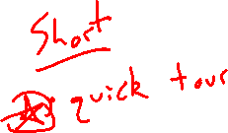
Chapter 10 Parametric Equations and Polar Equations
Introduction

Slide 2
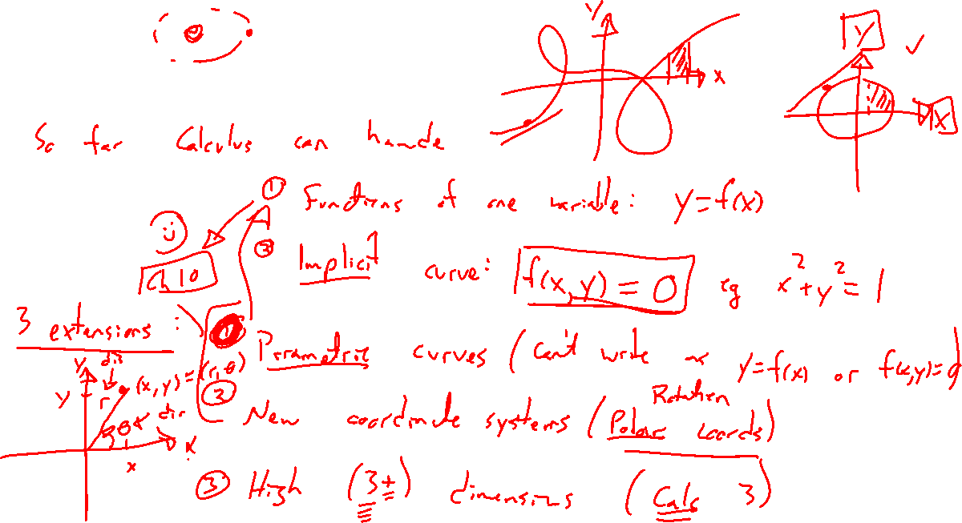
Extending our reach
Notes:
So far can do calculus for functions (y=f(x)) and implicit functions (0=f(x,y), ie x^2+y^2=1).
Extensions: Curves which arent functions (now), alternate coordinate systems (now), high dimension (calculus 3)
Newton planetary motion: https://en.wikipedia.org/wiki/Newton%27s_theorem_of_revolving_ orbits
Mars retrograde motion, three body problem

Slide 3
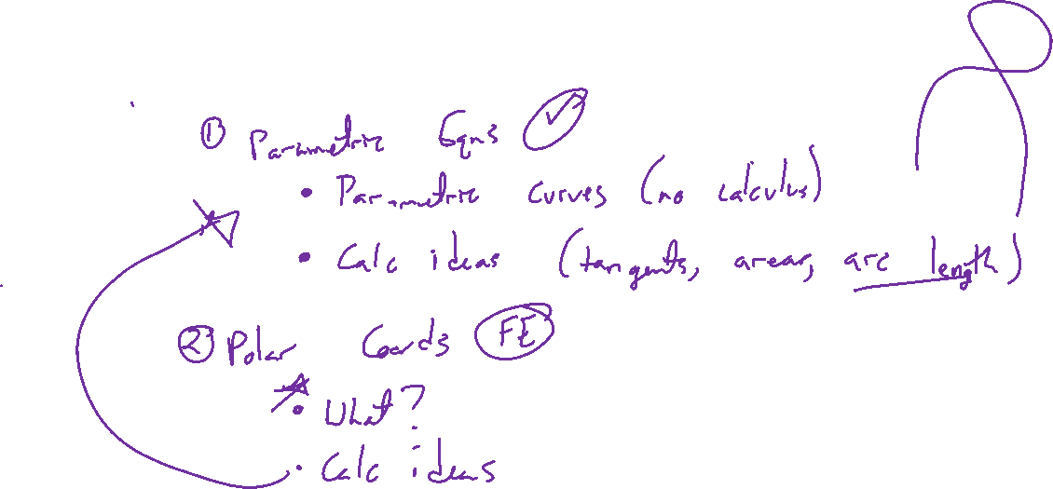
Outline of chapter
Notes:
Parametric equations: Tracing a curve with parameter t
Polar curves: New coordinate system made for rotation
Super fast thru each.

